Slide 1
CDC Information Modeling
Presentation to
ONC/FHA
Federal Health Information Modeling Standards Work Group (FHIMS)
Information Modeling Project
Gautam Kesarinath, MS
Associate Director Technology, Division of Informatics Shared Services
National Center For Public Health Informatics, CDC
November 20, 2009

Slide 2
Agenda
Organization
CDC Information Enterprise Level Domains of Interest
  Program Domains of Interest
HL7 or standards CDC has helped develop or are using in CDC
UML Model Samples
  Cancer Registry
  Vital Records
Q & A

Slide 3
CDC Proposed Organization
CDC Office of Director
Infectious Diseases
Non Communicable Diseases, Injury and Environmental Health
State & Local Support
Surveillance, Epidemiology and Laboratory Services
Center For Global Health

Slide 4
CDC Information Enterprise Level
Domains Of Interest
National Healthcare Safety Network
  Healthcare Acquired Infection Reporting
  Quality Measures
  Microbiology Laboratory reporting (aka ELR)
  Electronic medication administration reporting (eMAR)
Surveillance, Epidemiology and Laboratory
  Public Health Case Reporting
  Syndromic Surveillance
  Outbreak
  Vocabulary and Terminology
  Indicator meta data repository
  Collaboration with WHO IMR
  Survey Instruments
  Template Registry
Health Statistics
  Vital Records
Cancer Registries
Common Chronic Disease Surveillance Model

Slide 5
Program Domain of Interest – Cancer Registry NPCR – AERRO Scope Diagram
V1.0 Revised 12-11-2008
National Cancer Programs /Organizations
SEER
NAACCR
Medical Records
Disease Index
Specialty Databases
Admissions
Outpatient services
Diagnostic imaging
Pathology laboratory **
Treatment Logs
Radiation Oncology
Oncology clinics
Pharmacies
Business Office
***COC
NPCR
Hospitals with/without Registries
*1 Hospitals
* 2 Freestanding Pathology Laboratories **
*3 Cancer Treatment Facilities
*3 Freestanding healthcare practitioners
*4 Health insurance plans
*5 Bureau of Vital Statistics
*5 Census tract database
*5 State health departments
*6 IHS / Local Tribe Clinics
*7 National Death Index
*8 Nursing Homes / Hospices
8 Freestanding Diagnostic Imaging Centers
*8 State Cancer Registries
*9 Voter Registration, DMV
*10 Prisons
Central Cancer Registry
NPCR-AERRO includes cancer data sources and the lines drawn to the Central Cancer Registries and National Cancer Programs
Numbers rank the data sources on the quality of useful data available on a scale of 1 being most useful and 10 being least useful
* Pathology Laboratories – Freestanding and Hospital send data to both the Hospital Registries and the Central Cancer Registries
** CoC receives data directly from hospitals

Slide 6
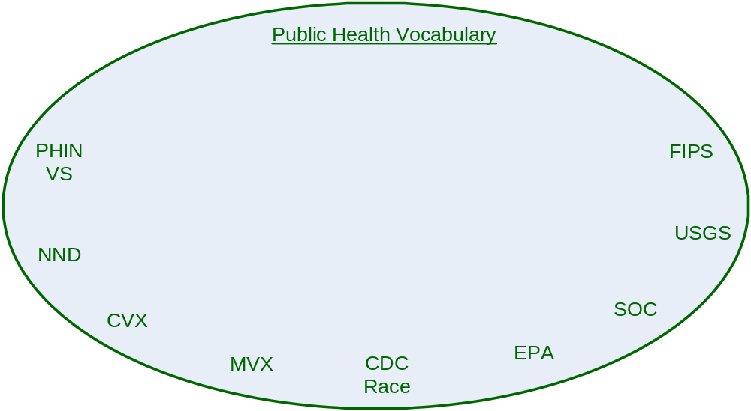
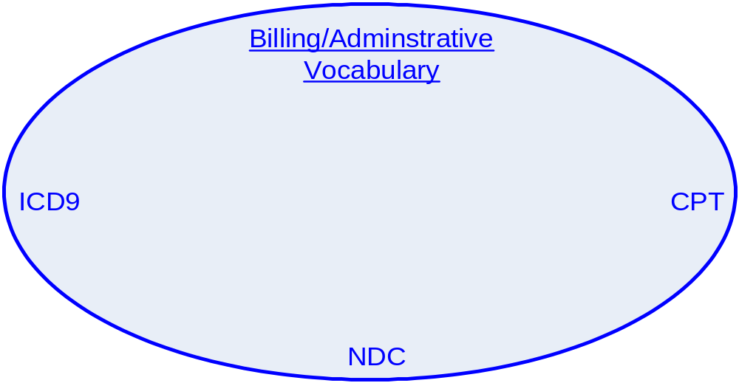
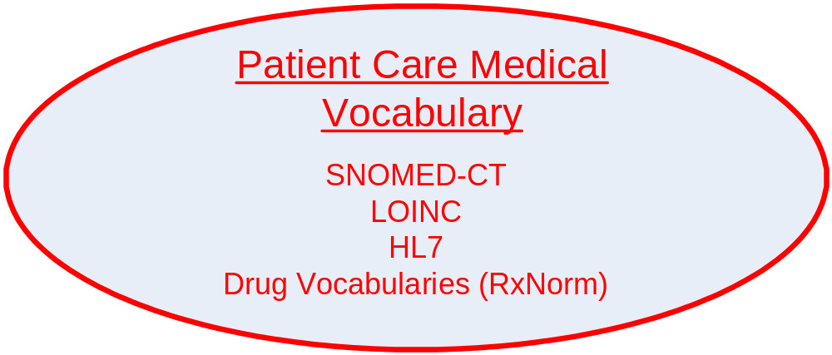
Program Domain of Interest – Vocabulary Terminology

Slide 7
Program Domain of Interest – Meta Data Repository
Surveillance
and Response
2. Health Status and Disease Management
3. Population-Based Research
4. Population-Based Health Care
5. Health Education/ Communication
6. Health IT Tools and Solutions, CDS
Surveillance Systems Monitoring Infectious Diseases
-121 Cities Mortality Reporting System
-Active Bacterial Core Surveillance (ABCs)
-Biosense
Chronic Diseases Surveillance
-Occupational Respiratory Disease Surveillance
-Pediatric and Pregnancy Nutrition Surveillance System
Injury and Violence Surveillance
-National Violent Death Reporting System (NVDRS)
Health Status and Disability of Diabetes patients
National Health Interview Survey
Morbidity of Persons with Heart Disease
National Ambulatory Medical Care Survey (NAMS)
Development of indicators to measure disparities in quality of care
Assessment of health disparities in areas of Immunization, Tobacco Cessation, Injury and Violence etc
Identifying populations with barriers to health and related services (i.e., elderly)
Development of interventions that address barriers of care (i.e. children with special needs, low income population etc.)
Guidelines for preventive services (e.g., flu, diabetes, obesity, asthma, etc.)
Vaccination schedules
Case definitions, syndrome definitions, diagnostic guidelines and criteria
Promotion of healthy communities and healthy behaviors
Outbreak Management System (OMS)
Epi-Info
Electronic Laboratory Results (ELR) Reporting
CDA for Public Health Reports

Slide 8
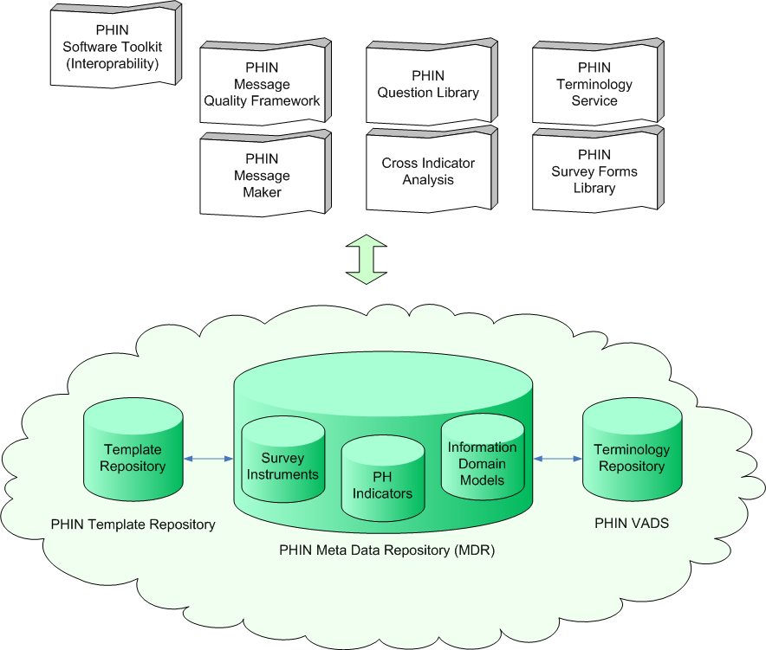
Program Domain of Interest – Meta Data Repository

Slide 9
HL7 or standards CDC has helped develop or are using in CDC
Links to the current standards that have been developed for use in Cancer Registries can be found at the following URLs:
NAACCR Volume II: http://www.naaccr.org/filesystem/pdf/Standards_Volume_II_Version_12_Revised.pdf (NAACCR Volume II is a flat file format, but we are currently testing the use of CDA to transmit Volume II data from Hospital Cancer Registries to State Cancer Registries.)
NAACCR Volume V – HL7 v.2.3.1 ORU Message: http://www.naaccr.org/filesystem/pdf/Standards_Volume_V_version_2.2_draftB_revised_February_2009.pdf
NAACCR Volume V – HL7 v.2.5.1 ORU Message: http://www.naaccr.org/filesystem/pdf/NAACCR_Vol_V_HL7v2.5.1.pdf
NAACCR Electronic Pathology (E-Path) Reporting Guidelines: http://www.naaccr.org/filesystem/pdf/E-Path%20Reporting%20Guidelines_FINAL_01-29-07%20.pdf
CDC’s National Program of Cancer Registries is working with NAACCR to develop standards for reporting the College of American Pathologists (CAP) Cancer Checklists from Laboratories to State Cancer Registries. This will move pathology reporting from a traditional text based report to a synoptic report.

Slide 10
HL7 or standards CDC has helped develop or are using in CDC
Current standards that have been developed for use by Public Health and the CDC
V3 Public Health CMETs (Some in Normative Edition 2009, others in Normative Edition 2010)
  A_PublicHealthStatement universal(COCT_RM480000UV) [NE2010]
  A_SpatialCoordinate universal(COCT_RM960000UV05) [NE2009]
  E_PublicHealthEntity universal(COCT_RM840000UV) [NE2010]
  E_PublicHealthFomite universal(COCT_RM841000UV08) [NE2009]
  E_PublicHealthManufacturedMaterial universal(COCT_RM841200UV) [NE2010]
  E_PublicHealthMaterial universal(COCT_RM841100UV) [NE2010]
  E_PublicHealthNonPersonLivingSubject universal(COCT_RM840100UV) [NE2010]
  E_PublicHealthOrganization universal(COCT_RM841400UV) [NE2010]
  E_PublicHealthPathogen universal(COCT_RM840500UV08) [NE2009]
  E_PublicHealthPerson universal(COCT_RM840200UV) [NE2010]
  E_PublicHealthPhysicalEntity universal(COCT_RM841500UV) [NE2009]
  E_PublicHealthPlace universal(COCT_RM841300UV) [NE2010]
  E_PublicHealthVector universal(COCT_RM840300UV) [NE2010]
  R_ExposureAgentCarrier universal(COCT_RM410000UV07) [NE2009]
  R_ExposureAgentFomite universal(COCT_RM411000UV07) [NE2009]
  R_ExposureAgentVector universal(COCT_RM410300UV07) [NE2009]
  R_InvestigativeSubject universal(COCT_RM550000UV07) [NE2009]
  R_Subject universal(COCT_RM560000UV07) [NE2009]
V3 Laboratory Results Domain (Normative Edition 2009)
  Result Event(POLB_RM004000UV01)
  Result Query(POLB_RM300000UV01)
  A_OrderOptions universal(COCT_RM210000UV02)
  A_LaboratoryProcessStep universal(COCT_RM570000UV08)
  R_LabTestKit universal(COCT_RM430000UV08)
  R_Reagent universal(COCT_RM250000UV03)
  V3 Specimen CMETs (To be included in Normative Edition 2010)
  R_Specimen lite(COCT_RM080200UV)
  R_Specimen minimal(COCT_RM080100UV)
  R_Specimen universal(COCT_RM080000UV)

Slide 11
HL7 or standards CDC has helped develop or are using in CDC
Standards that are in process by NHSN
HL7 V3 Work In Progress
  HL7 Clinical Document Architecture, Release 3 – Still in requirements gathering, no models yet. Broad requirements for public health reporting are in scope for the project.
  HL7 SAEAF Behavioral Framework applied to Laboratory ordering/resulting. This is still in requirements gathering phase.
Other HL7 Standards Work In Progress
  HL7 Version 2.5.1 Implementation Guide: Electronic Laboratory Reporting to Public Health (US Realm) Release 1
  HL7 Version 2.5.1 Implementation Guide: National Healthcare Safety Network eSURVEILLANCE (US Realm), Release 1

Slide 12
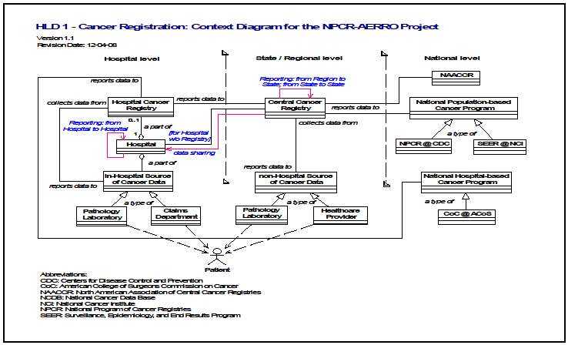
UML Models – Cancer Registry – Context Diagram
http://www.cdc.gov/cancer/npcr/informatics/merp2/master.htm

Slide 13
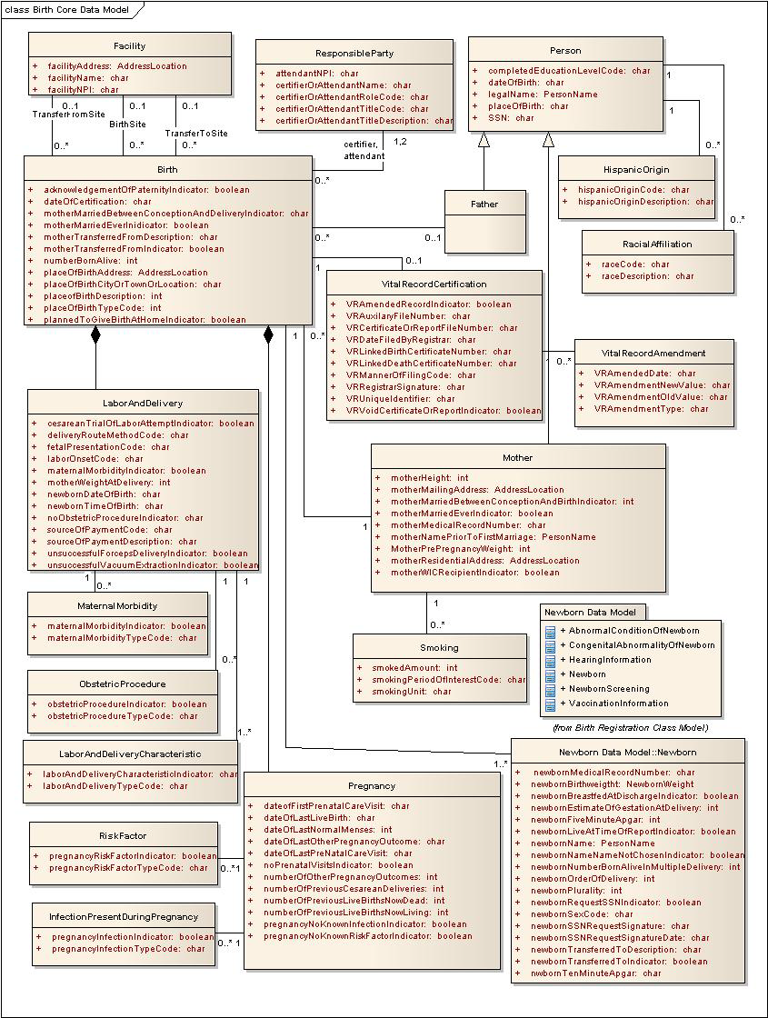
UML Models - Vital Records – Birth Core Data Model

Slide 14
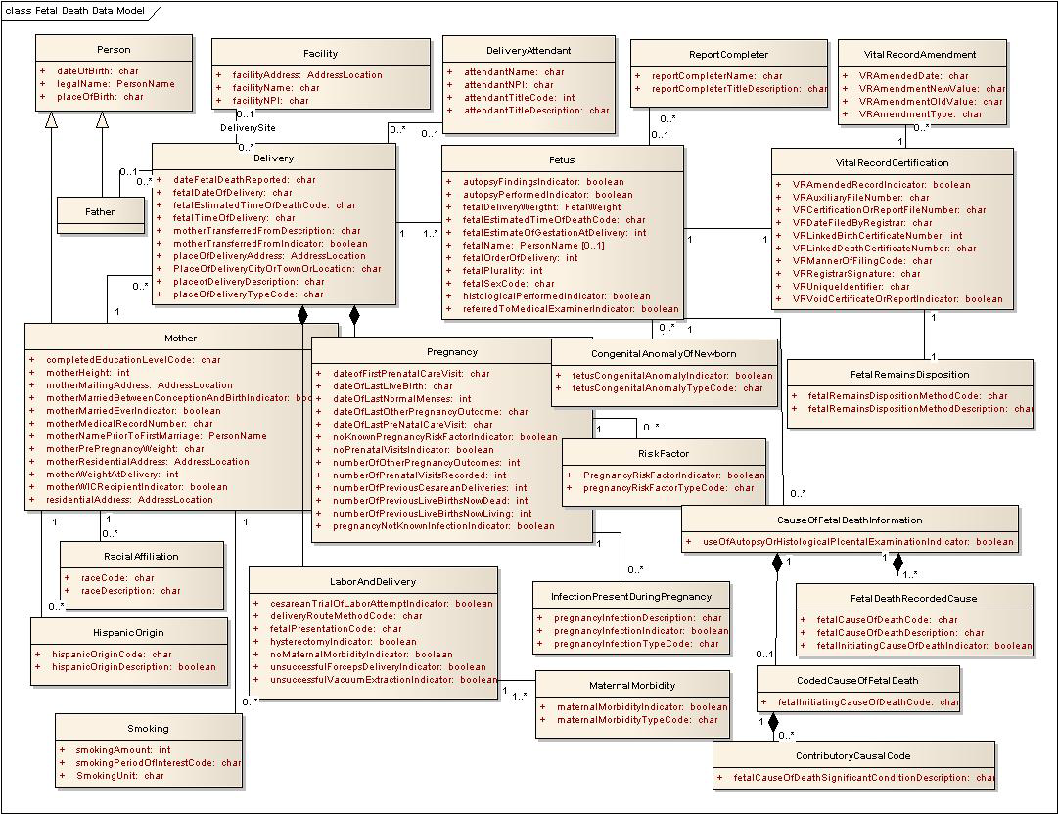
UML Models - Vital Records – Fetal Death Data Model

Slide 15
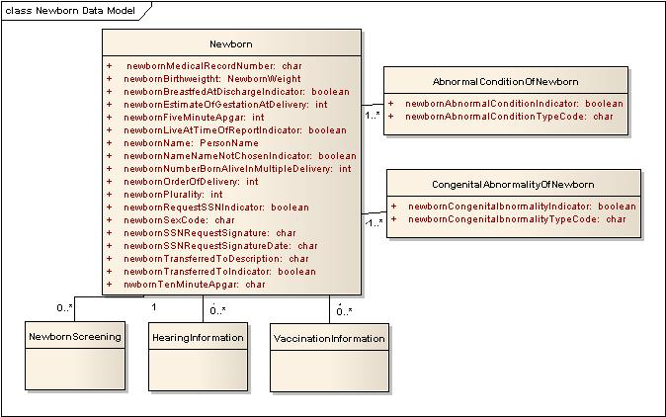
UML Models - Vital Records – Newborn Data Model

Slide 16
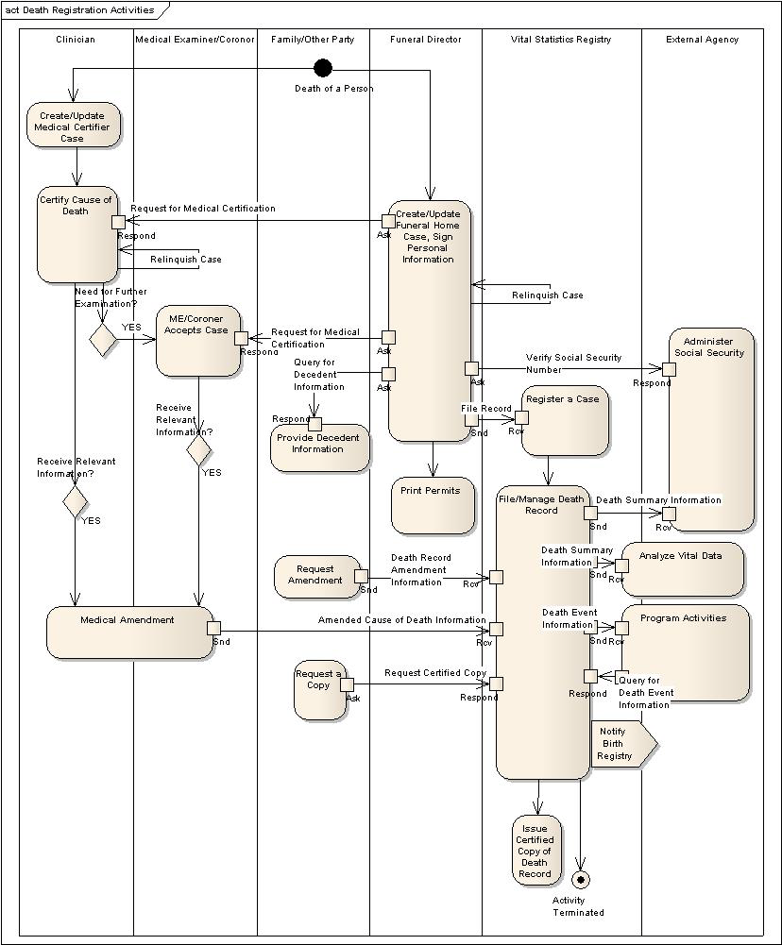
UML Models - Vital Records – Death Registration Activity Diagram

Slide 17
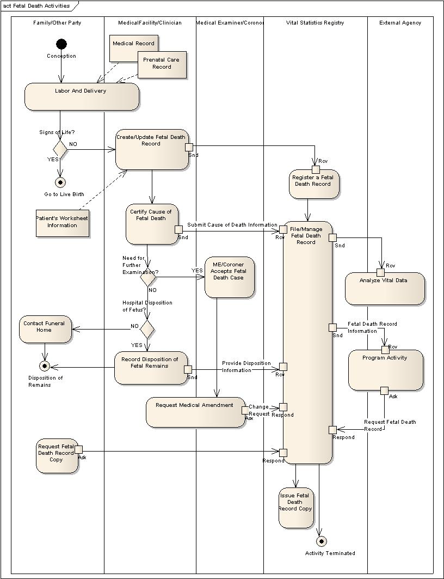
UML Models - Vital Records – Fetal Death Activity Model

Slide 18

Questions & Acknowledgements
CDC/National Center for Health Statistics
Michelle Williamson
Charles Rothwell
Marjorie Greenberg
Delton Atkinson
Joyce Martin
Donna Hoyert
Hetty Khan
CDC/Division of Health care Quality Promotion
Dan Pollock
Austin Kreisler
Barry Rhodes
CDC/Division of Cancer Prevention
and Control
Sandy Thames
Joe Rogers
Ken Gerlach
Wendy Blumenthal
CDC/National Center for Chronic Disease
Prevention and Health Promotion/Office of
Informatics & Information Resource
Management
Jason Bonander
CDC/Division of Informatics Shared Services
Nikolay Lipsky
Sundak Ganesan

